Slide 1
Machine Learning CSE - 403 Lecture - Data Pre-processing

Slide 2
Outline
Introduction to Data
Types of Data
Handling Missing Data
Handling Outliers
Feature Scaling
Encoding Variable

Slide 3
Introduction to Data
What is Data?
Data is a collection of facts, values, observations, or measurements that can be used for analysis, decision-making, or learning.
In simple words:
Data is raw information collected from the real world.

Slide 4
Everyday Examples of Data
Situation | Data
Student examination | Marks, attendance, CGPA
Hospital | Patient age, blood pressure, diagnosis
Online shopping | Product price, ratings, customer reviews
Weather system | Temperature, humidity, rainfall
Social media | Likes, comments, shares

Slide 5
Simple Classroom Example
Suppose we collect information about students:
Name | Age | CGPA
Hasan | 22 | 3.75
Jahid | 21 | 3.46
Disha | 20 | 3.72
Here:
Each row represents one student
Each column represents one feature/attribute
The entire table is called a dataset

Slide 6

Important Terminologies
1. Dataset
A complete collection of data.
Example: A table containing 1000 student records.
2. Instance / Record / Tuple/ Data point
A single row of data.
Example: This single row is one instance.

Slide 7
Important Terminologies
3. Feature / Attribute / Column
Characteristics or properties of the data.
Examples:
Age
Height
Salary
Marks

Slide 8
Why is Data Important?
Data helps us:
Make decisions
Discover patterns
Predict future outcomes
Train Machine Learning models
Example:
Netflix recommends movies using user data
Banks detect fraud using transaction data
Hospitals predict diseases using patient data

Slide 9
Types of Data
3. Text Data
Contains words or sentences.
Examples: Reviews, Comments, Emails
4. Image Data
Photos or pictures.
Examples: Face images, Medical scans, Satellite images
5. Audio Data
Sound recordings.
Examples: Voice commands, Music, Speech recordings
1. Numerical Data
Contains numbers.
Examples: Age, Salary, Temperature
2. Categorical Data
Contains categories or labels.
Examples: Gender, Blood Group, Department

Slide 10
Structured vs Unstructured Data
Structured Data
Organized in rows and columns.
Examples:
Excel sheet, database table, CSV Files
Unstructured Data
No fixed format.
Examples:
Images
Videos
Social media posts
Audio files

Slide 11
Task : Guess the Feature
Which are features?
Which are numerical?
Which are categorical?
Name | Gender | Height | Weight | Blood Group

Slide 12
Task : Data Sorting
Find out the structured and unstructured data.
Excel sheet
Facebook post
X-ray Images
Student database
Voice recording

Slide 13
Bad Data vs Good Data
Example of messy data:
Name | Age | CGPA
Hasan | 22 | 3.75
Jahid | ? | 3.46
Disha | 20 | abc

Slide 14
What Are Missing Values?
Missing values occur when data is not recorded for a variable.
Represented as:
NaN (Not a Number)
None
Empty cells
Special symbols (e.g., ?, -1)

Slide 15
Why Handling Missing Values Is Important
Machine learning algorithms cannot work properly with missing data.
It Can cause:
Incorrect model training
Biased results
Errors during computation
Proper handling improves accuracy and reliability.

Slide 16
Common Reasons for Missing Values
Data entry errors
Sensor or system failure
Survey participants skipping questions
Data merging from multiple sources

Slide 17
Types of Missing Values
• MCAR (Missing Completely at Random): Missingness is random, no relation to any variable. (e.g., random technical error)
• MAR (Missing at Random): Missingness depends on other observed variables, not the missing one itself. (e.g., younger people skipping a survey question)
• MNAR (Missing Not at Random): Missingness depends on the value of the missing data itself. (e.g., high-income individuals not reporting income

Slide 18
Handling Missing Data
Remove Missing Values
a) Remove Rows
Used when:
Very few rows contain missing values
Risk: loss of useful data
b) Remove Columns
Used when:
A column has a large percentage of missing values

Slide 19
Handling Missing Data
2. Imputation (Filling Missing Values)
a) Mean Imputation
Replace missing values with the mean
Suitable for numerical data
Sensitive to outliers
b) Median Imputation
Replace with the median
Better when data has outliers
c) Mode Imputation
Replace with the most frequent value
Best for categorical data

Slide 20
Handling Missing Data
d) End of Distribution Imputation:
It is a technique where missing values are replaced with extreme values at the end (tail) of a variable’s distribution.
Useful when missing values are not random
Missing values are replaced with:
Very small value → mean − 3 × standard deviation
Very large value → mean + 3 × standard deviation

Slide 21
Handling Missing Data
d) Example
Suppose a variable Age has:
Mean = 40
Standard Deviation = 10
Then:
Lower extreme = 40 − 3×10 = 10
Upper extreme = 40 + 3×10 = 70
All missing Age values can be replaced with 10 or 70.

Slide 22
Handling Missing Data
3. Forward Fill & Backward Fill
Forward Fill (ffill): fills using previous value
Backward Fill (bfill): fills using next value
Common in time-series data
4. Predictive Imputation
Missing values predicted using:
Regression
KNN
Machine Learning models
More accurate but computationally expensive

Slide 23
Handling Missing Data
4. Example:
KNN Imputer:
For each missing value, find the k nearest records (based on Euclidean distance or other distance metrics).
Then, Impute the missing value using their average (for numeric) or majority vote (for categorical).
When to Use: Suitable when dataset has moderate missingness (5–20%) Works best when features are correlated.

Slide 24

Standard Deviation
Where:
s = sample standard deviation
xi = each sample value
x̄ = sample mean
n = number of sample data points
2, 4, 4, 4, 5, 5, 7, 9 - Std dev?

Slide 25
Standard Deviation
Small standard deviation → data points are close to the mean
Large standard deviation → data points are widely spread out
Example:
Students scoring nearly the same marks → low SD
Students having very different marks → high SD

Slide 26
Outliers : What is an Outlier?
An outlier is a data point that is significantly different from the other data points in a dataset.
In simple words:
An outlier is an unusual or abnormal value that does not follow the general pattern of the data.
Suppose we measure the heights (in cm) of 5 students:
A = 165 cm
B = 170 cm
C = 168 cm
D = 167 cm
E = 245 cm
Most students have heights between 165 cm and 170 cm, which is a normal range.
But student E (245 cm) is very far from the others.

Slide 27
Outliers
Why Do Outliers Occur?
1. Data Entry Errors
Example:
Typing 500 instead of 50
2. Measurement Errors
Faulty sensors or instruments.
3. Natural Variations
Sometimes unusual values are real.
Example:
Extremely rich person's income
4. Experimental Errors
Problems during data collection.

Slide 28
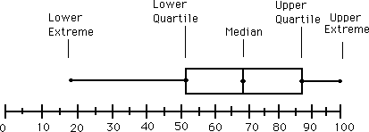
Handling Outliers
Quartiles, outliers and boxplots
Quartiles: Q₁ (25th percentile), Q₃ (75th percentile)
Inter-quartile range: IQR = Q₃ – Q₁
Five number summary: min, Q₁, median, Q₃, max
Boxplot: ends of the box are the quartiles; median is marked; add whiskers, and plot outliers individually
Outlier: usually, a value higher/lower than 1.5 x IQR

Slide 29
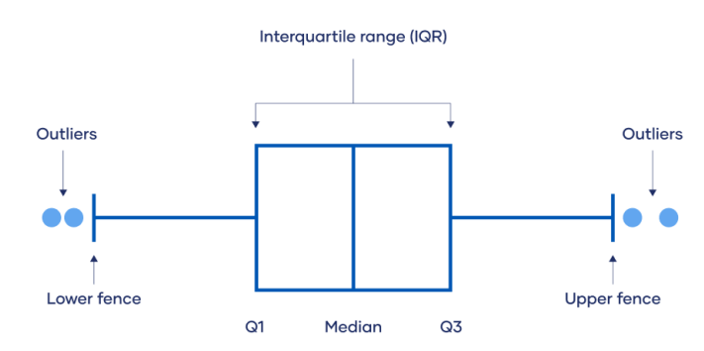
Handling Outliers

Slide 30
Feature Scaling
What is Feature Scaling?
Feature scaling is a preprocessing technique used to bring numerical features to a common scale so that no feature dominates others due to its magnitude.
Why Feature Scaling is Needed
ML algorithms use distance or gradient
Features with larger values dominate:
KNN
K-Means
SVM
Faster convergence in training
Improves model performance

Slide 31


Feature Scaling
Normalization (Min–Max Scaling)
Normalization rescales features to a fixed range, usually [0, 1].
Standardization (Z-Score Scaling)

Slide 32
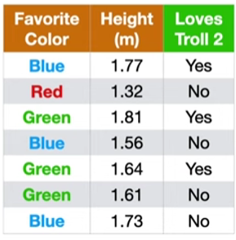
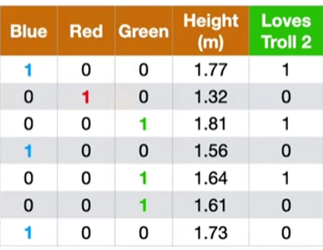
Encoding Categorical Variable
One-hot encoding is a technique to represent categorical variables as binary dummy variables. For a categorical variable with k categories, one hot encoding produces k binary columns. Not suitable for high cardinality feature

Slide 33
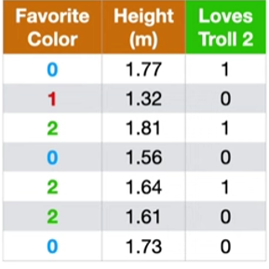
Encoding Categorical Variable
2. Label encoding: Find all unique categories in the column. Assigns an integer ID to each category.

Slide 34
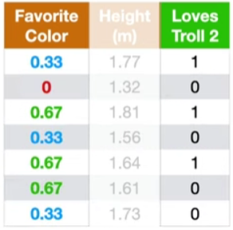
Encoding Categorical Variable
3. Target encoding: Replace each category with a statistic of the target variable (like mean).
Blue =3, target = 1, mean = 1/3=0.33
Red =1, target = 0, mean = 0/1 =0
Green =3, target = 2, mean = 2/3=0.67

Slide 35
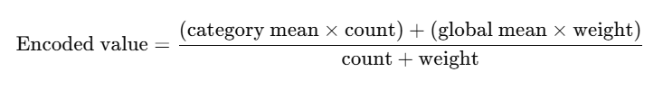
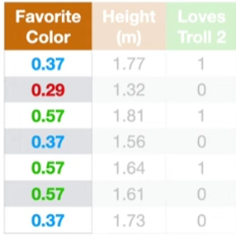
Encoding Categorical Variable
4. Weighted Target encoding: Replace each category with a statistic of the target variable (like mean).
n=count (usually the number of rows)
m= weight for global mean (user defined)
Overall/global mean = 3/7 =0.42
category 1 = Blue, category mean = 1/3 = 0.33
category 2=Red, category mean = 0/1=0
category 3=Green, category mean = 2/3= 0.667
let m=2
weighted mean of blue = 3*0.33 + 2*0.42 / 3+2 =0.37
weighted mean of red = 1*0 + 2*0.42 / 1+2 =0.29
weighted mean of green =3*0.66 + 2*0.42 / 3+2 =0.57

Slide 36
Encoding Categorical Variable
4. Weighted Target encoding: It causes data leakage
Data leakage happens when information from outside the training data (especially from the target/label) is used to create features, causing the model to “cheat”.
Leakage occurs because:
Test labels influenced the encoded values
Model indirectly “knows” test answers

Slide 37
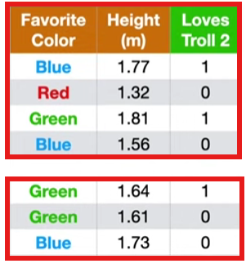
Encoding Categorical Variable
5. K-Fold Target encoding: To reduce data leakage as the rows do not use their own target values to calculate encoding
Splitting the data into equal size of subsets : 2-fold
Subset A:
weighted mean of blue = 1*0 + 2*0.33 / 1+2 =0.22
weighted mean of red = 0*0 + 2*0.33 / 0+2 = 0.33
weighted mean of green =2*0.5 + 2*0.33 / 2+2 =0.42
Subset B:
weighted mean of blue = 2*0.5 + 2*0.5 / 2+2 =0.5
weighted mean of red = 1*0 + 2*0.5 / 1+2 =0.33
weighted mean of green =1*1 + 2*0.5 / 1+2 =0.67
Subset A
Subset B

Slide 38
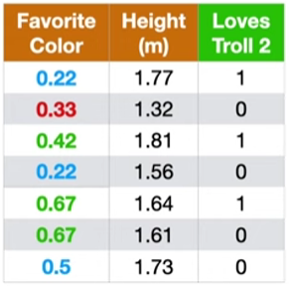
Encoding Categorical Variable
5. K-Fold Target encoding:
Subset A
Subset B

Slide 39
Task 1
ID | Name | Age | Gender | Study Hours | Attendance | CGPA | Passed
1 | Rahim | 21 | Male | 4 | 85 | 3.4 | Yes
2 | Karim | 22 | male | 5 | 90 | 3.8 | Yes
3 | Ayesha | ? | Female | 3 | 78 | 3.2 | Yes
4 | Nadia | 20 | Female | NULL | 88 | 3.6 | Yes
5 | Hasan | 23 | Male | 2 |  | 2.5 | No
6 | Fatema | 21 | FEMALE | 4 | 92 |  | Yes
7 | Akash | twenty | Male | 3 | 80 | 3.1 | Yes
8 | Sumi | 22 | Female | -2 | 95 | 3.9 | Yes
9 | Tanvir | 24 | M | 5 | 87 | 2.8 | No
10 | Rahim | 21 | Male | 4 | 85 | 3.4 | Yes
Identify all missing values.
Which records contain invalid values?
Which columns have inconsistent formatting?
Are there any duplicate records?
How would you handle:
Missing age?
Missing attendance?
Missing CGPA?
What is wrong with the values:
twenty
-2
M
Which row appears duplicated?
How would you standardize the Gender column?
What steps would you perform before using this dataset for machine learning?
Why is data cleaning important?

Slide 40
Thank You

